Slide 1
Unit 8
Teacher: iddo sadeh

Slide 2
2d arrays
real world data often needs to be stored in multi-dimensional arrays (for example: for a user data base every username will have a password attached)
- 2D arrays in Java are just Arrays in Arrays.

Slide 3
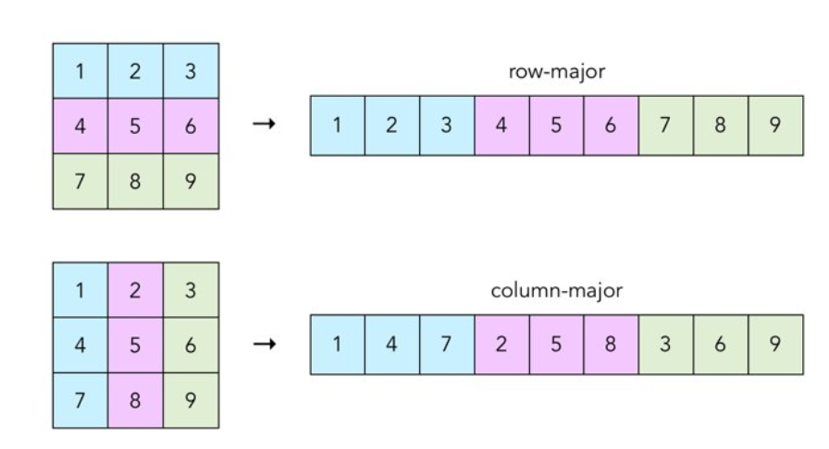

Row major and column major arrays
*image courtesy of https://craftofcoding.wordpress.com/2017/02/03/column-major-vs-row-major-arrays-does-it-matter/
Notes:
The way that arrays are stored in languages doesn’t get much in the way of discussion. C is row-major (as is C++, Pascal, and Python), Fortran is column-major (as is Julia, R and Matlab). But what does this really mean? It’s all about how the arrays are stored in memory: row major stores an array row-by-row, and column major stores an array column-by-column. Now in the overall scope of things, it doesn’t really matter which is used. Here’s what it means from a visual perspective.
Question1

Slide 4
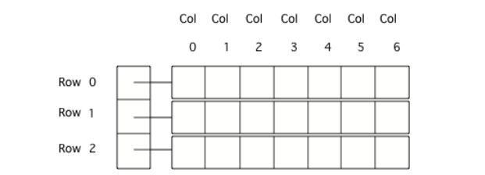
Java 2d arrays
*picture taken from https://csawesome.runestone.academy/runestone/books/published/csawesome/Unit8-2DArray/topic-8-1-2D-arrays-Day1.html
Notes:
On the exam assume that any 2 dimensional (2D) array is in row-major order. The outer array can be thought of as the rows and the inner arrays the columns. On the exam all inner arrays will have the same length even though it is possible in Java to have inner arrays of different lengths. 2D array objects that are not rectangular (that are ragged arrays) are outside the scope of the course and AP Exam.

Slide 5
Declaring 2d arrays
To declare a 2D array, specify the type of elements that will be stored in the array, then ([][]) to show that it is a 2D array of that type, then at least one space, and then a name for the array.
Declarations do not create the array.
Arrays are objects in Java, so any variable that declares an array holds a reference to an object.
If the array hasn’t been created yet and you try to print the value of the variable, it will print null (meaning it doesn’t reference any object yet).

Slide 6
Creating 2d Arrays
To create an array use the new keyword, followed by a space, then the type, and then the number of rows in square brackets followed by the number of columns in square brackets, like this new int[numRows][numCols].

Slide 7
Declaring 2d arrays
datatype[][] arrayName;
Creating 2d arrays
arrayName = new datatype [numRows][numCols];

Slide 8
Setting values in a 2D array
When arrays are created their contents are automatically initialized to 0 for numeric types, null for object references, and false for type boolean.
To explicitly put a value in an array, you can use assignment statements with the name of the array followed by the row index in brackets followed by the column index in brackets and then an = followed by a value:
datatype[][] arrayName=new datatype[rows][cols];
arrayName[rowIndex][colIndex] = value;
Notes:
Q

Slide 9
Setting multiple values at once
You can set values for the array when you create it.
You don’t need to specify the size in this case.
Example:
String[][] grades = { {“Math”,”History”,”Literature”},{“88”,”24”,”62”}};
Notes:
Question 2,3,4,5,6
Go to next slide after question 5, return for question 6

Slide 10
Getting a value form a 2d array
To get the value in a 2D array give the name of the array followed by the row and column indicies in square brackets
For example:
String mathGrade = grades[1][0];

Slide 11
Traversing 2d arrays – Array lengths
Arrays know their length (how many elements they can store).
The length is a public read-only field so you can use dot-notation to access the field (arrayName.length).
The length of the outer array is the number of rows and the length of one of the inner arrays is the number of columns.
*taken form https://csawesome.runestone.academy/runestone/books/published/csawesome/Unit8-2DArray/topic-8-2-2D-array-loops-Day1.html
Notes:
Question 7

Slide 12
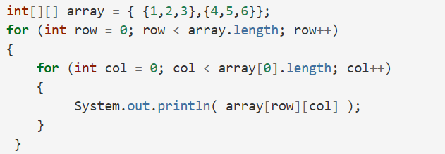
Traversing 2d arrays - loops
you can use a nested for loop (one loop inside of another loop) to loop/traverse through all of the elements of a 2D array
*taken form https://csawesome.runestone.academy/runestone/books/published/csawesome/Unit8-2DArray/topic-8-2-2D-array-loops-Day1.html

